Slide 2
Dr. Michael Shavelle, Ph.D.
Notes:
13:23 – 15:11

Slide 3
Dr. Michael Shavelle, Ph.D.
Notes:
22:22 – 23:06

Slide 4
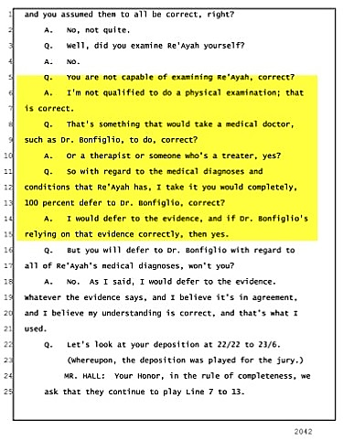
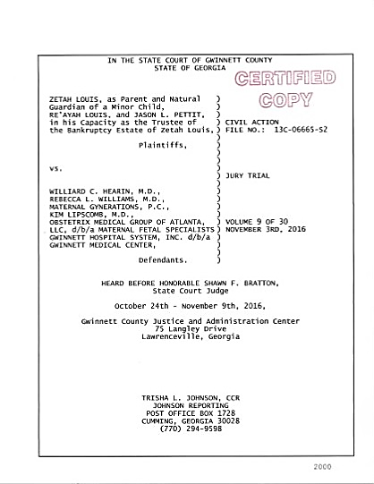
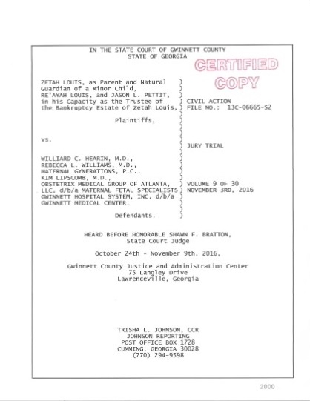

Slide 6
Dr. Michael Shavelle, Ph.D.
Notes:
83:15 – 83:19

Slide 7
Dr. Michael Shavelle, Ph.D.
Notes:
84:06 – 84:14

Slide 8
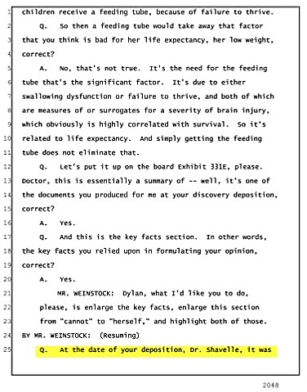
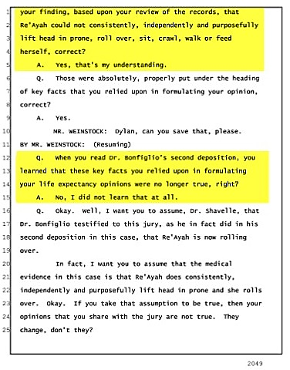

Slide 9
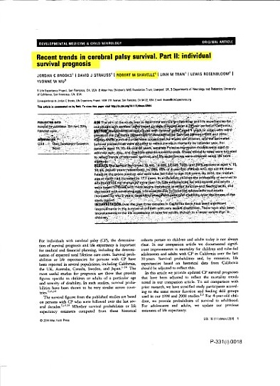
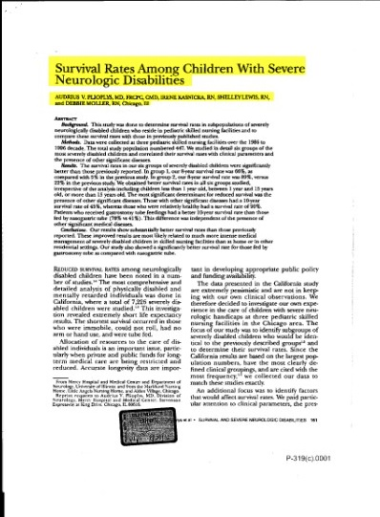
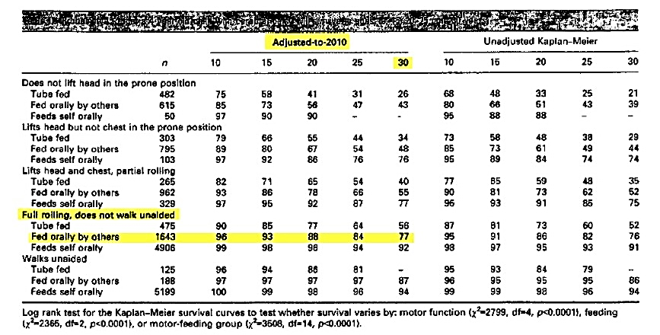
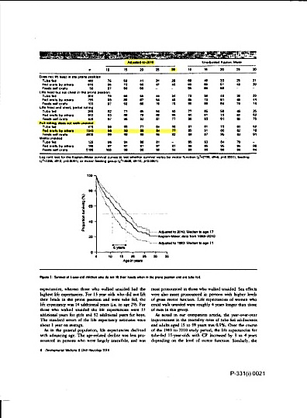
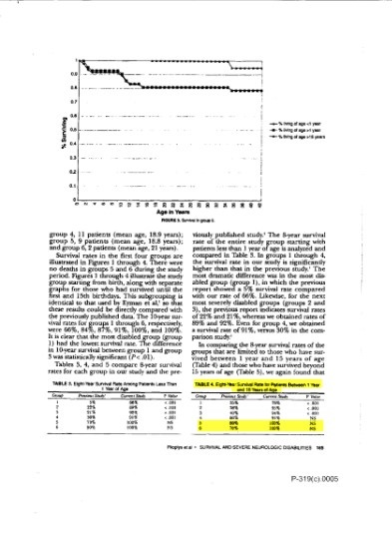
Probability (%) that a 4-year-old child with cerebral palsy will
survive to ages 10, 15, 20, 25, & 30 years

Slide 10
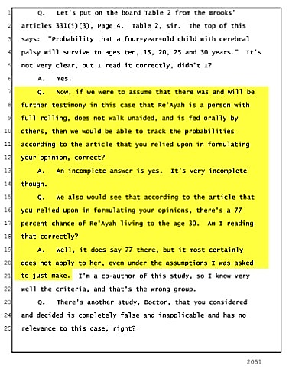

Slide 11
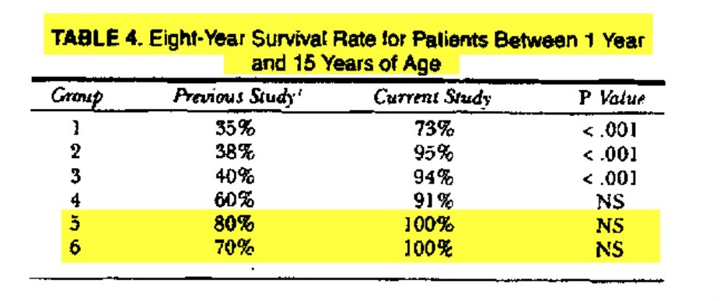
Survival Rates Among Children With Severe Neurologic Disabilities

Slide 12
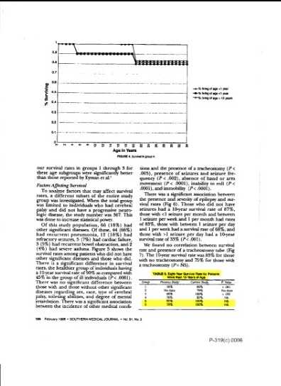
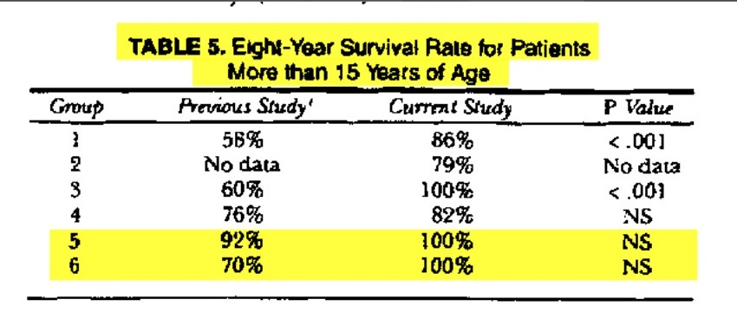
Survival Rates Among Children With Severe Neurologic Disabilities

Slide 13
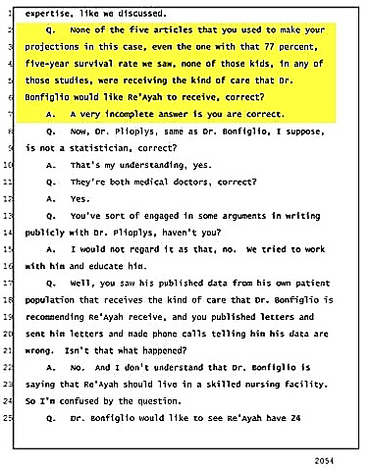

Slide 14
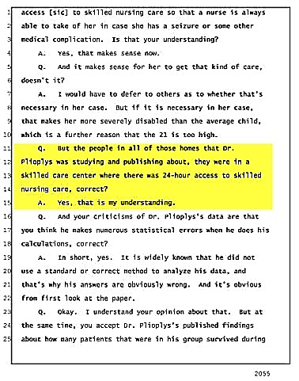

Slide 15
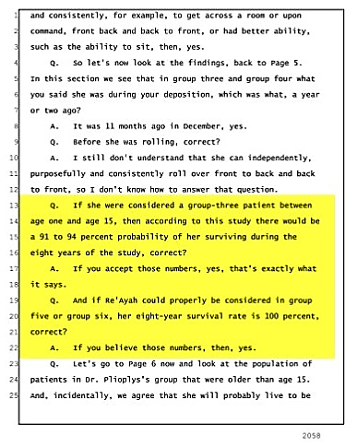

Slide 16
