Slide 5
Notes:
Johnson: McCarey 29:13 – 33:21
3min, 26sec

Slide 10
Notes:
mcCarey 34:10 through 36:5
1min 13 sec

Slide 11
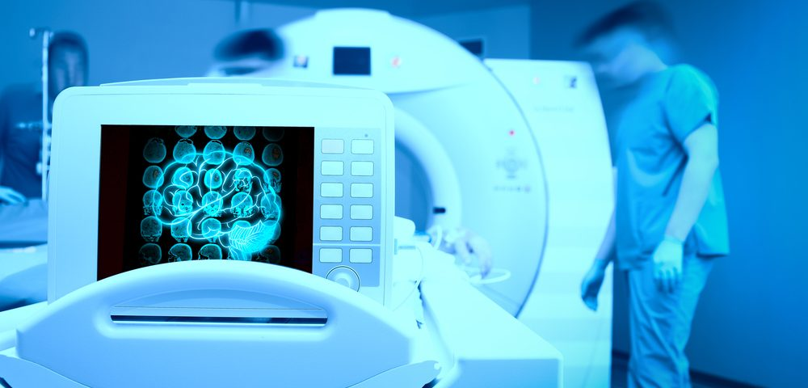
Importance of Reviewing Images

Slide 13
Exposing alternative facts in the medical records

Slide 16
Notes:
Luckenbill clip: 21:11 through 22:11
45 sec

Slide 17
Notes:
Carola clip: 25:2 through 27:13
2 min 50 sec

Slide 18
Notes:
Karasick clip: 51:3 through 51:7
12 secs

Slide 20
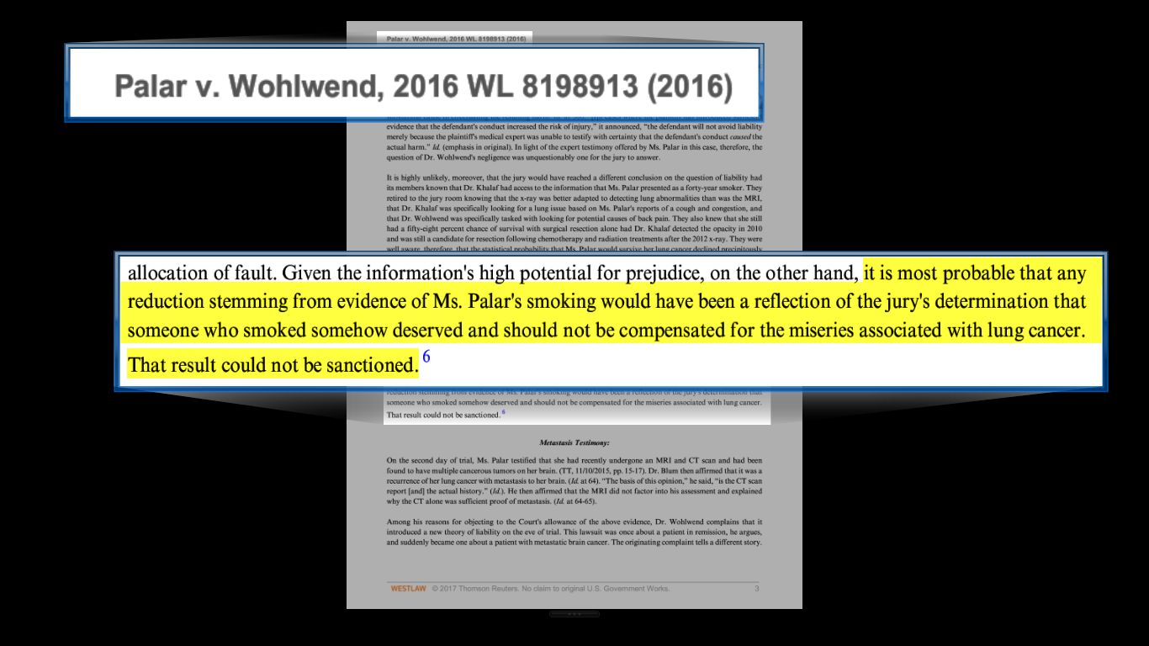
Trial Court Opinion

Slide 21
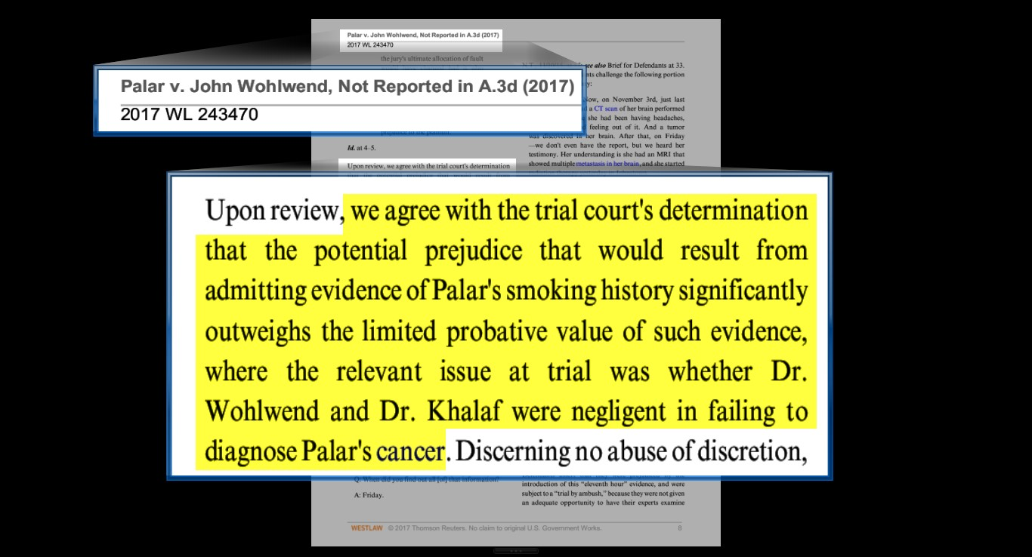
Affirmed on Appeal
appeal denied, 2017 WL 4351303 (Pa. 2017)(“The potential prejudice that would result from admitting evidence of Palar's smoking history significantly outweighs the limited probative value of such evidence, where the relevant issue at trial was whether Dr. Wohlwend and Dr. Khalaf were negligent in failing to diagnose Palar's cancer.”)

Slide 22
Notes:
Greaney p. 22
33secs

Slide 23
Notes:
Greaney p. 134
1min 6 secs

Slide 27
Dilaudid Warning from PDR

Slide 28
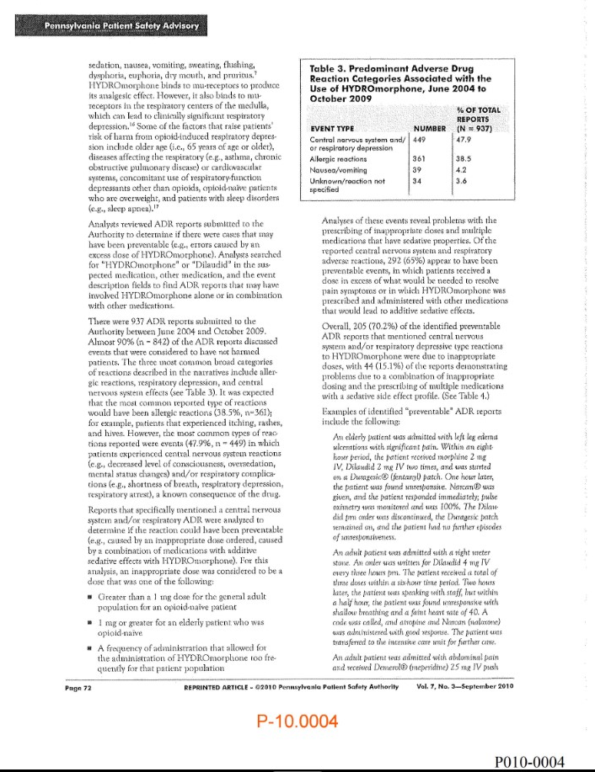
Patient Safety Advisory – 2010

Slide 29
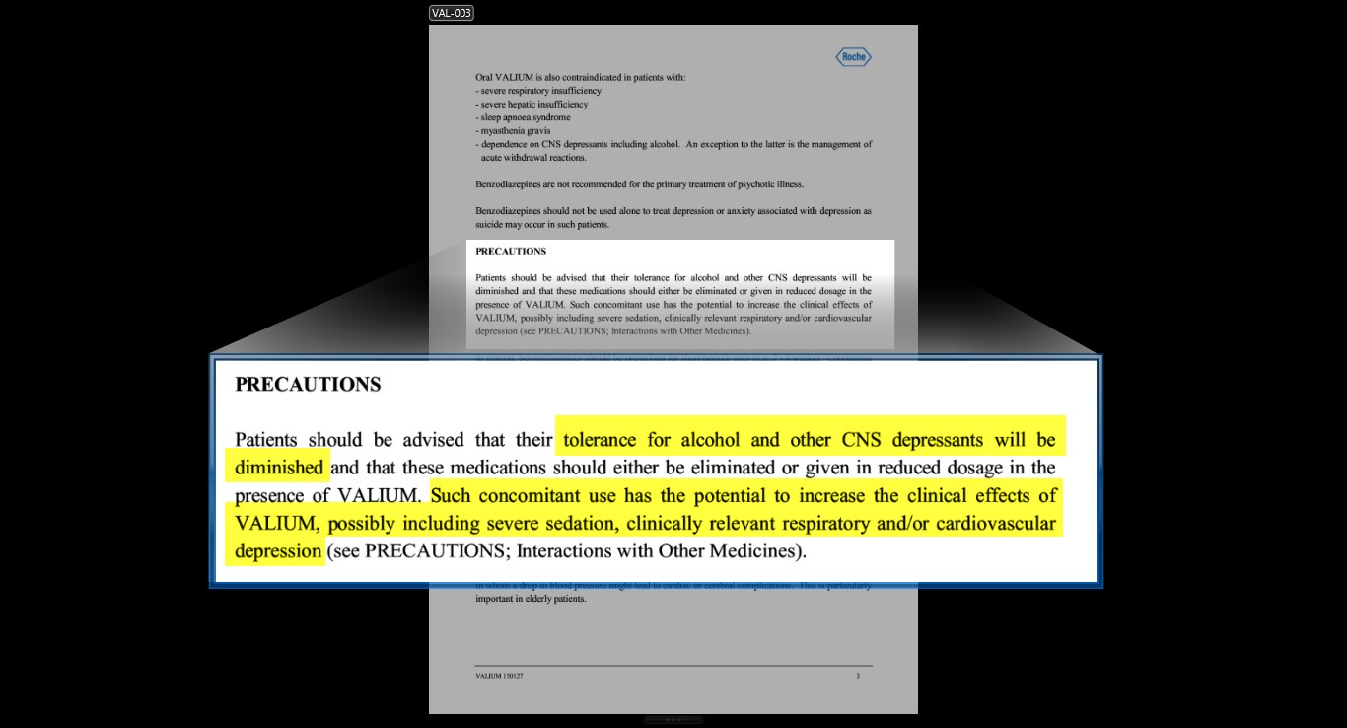
Valium Warning from PDR

Slide 30
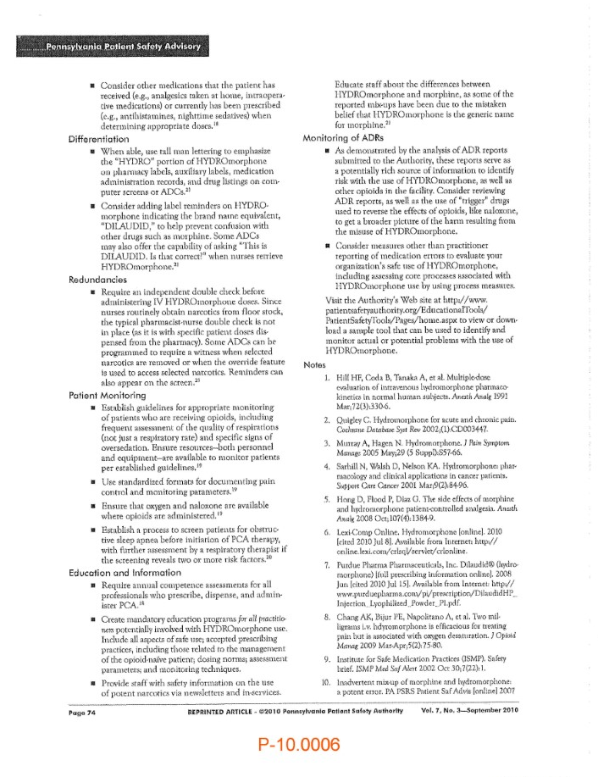
Patient Advisory Recommendations

Slide 31
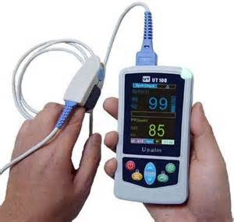
Pulse Oximetry

